Slide 1
SAP EWM EXTENDED WAREHOUSE MANAGEMENT TRAINING
AnubhavTrainings.com
www.anubhavtrainings.com

Slide 2

SAP EWM TRAINING
BY:-
Mr. Bijoy
www.anubhavtrainings.com
Notes:
https://unsplash.com/photos/uXB-7la5vqA

Slide 3
Inbound Process / Putaway Process
Delivery document types for Inbound, Item types for Inbound,
Putaway strategies, Storage type Search, Storage section search, Storage bin determination
End to End Inbound process – testing execution

Slide 4
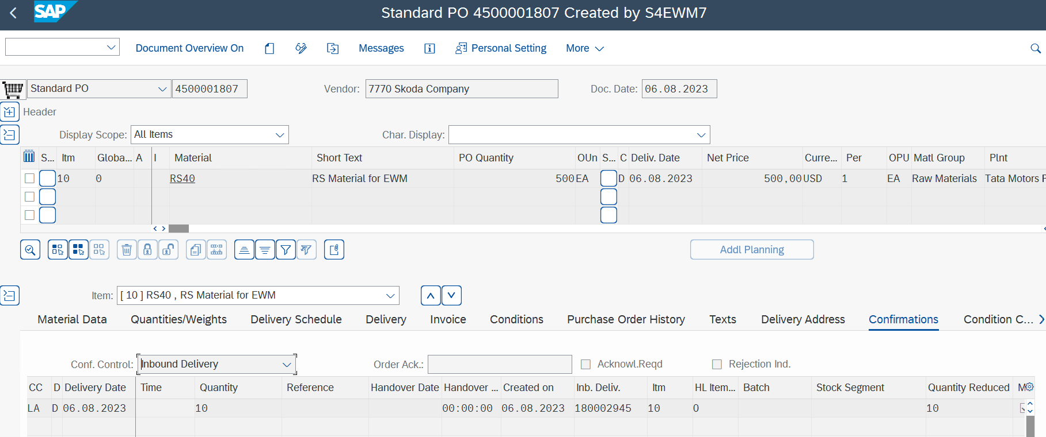
Inbound Process:
Step 1: Creation of purchase order (T-code: ME23N)

Slide 5
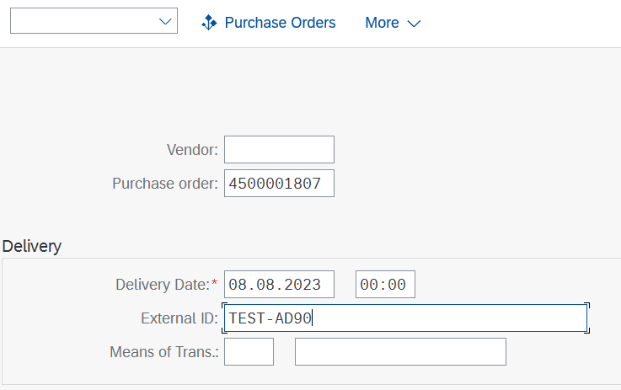
Step 2: Create Inbound delivery against the purchase order (T code: VL31N)
You can enter ASN number provided by the supplier for your reference in “External ID” field.

Slide 6
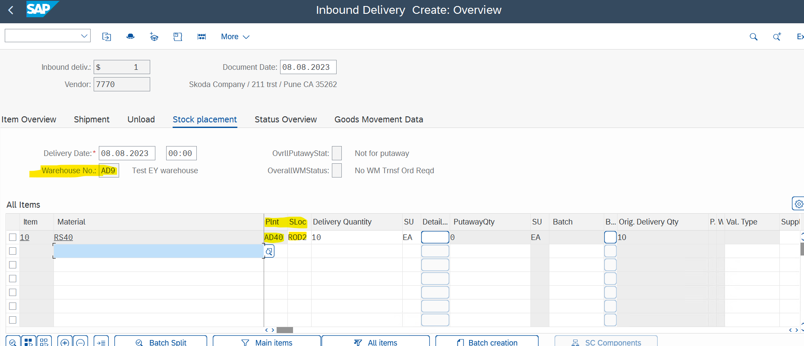
Please check the plant + SLOC combination because this will determine your warehouse number.
Once you enter the required qty and save, delivery will be distributed to EWM.

Slide 7
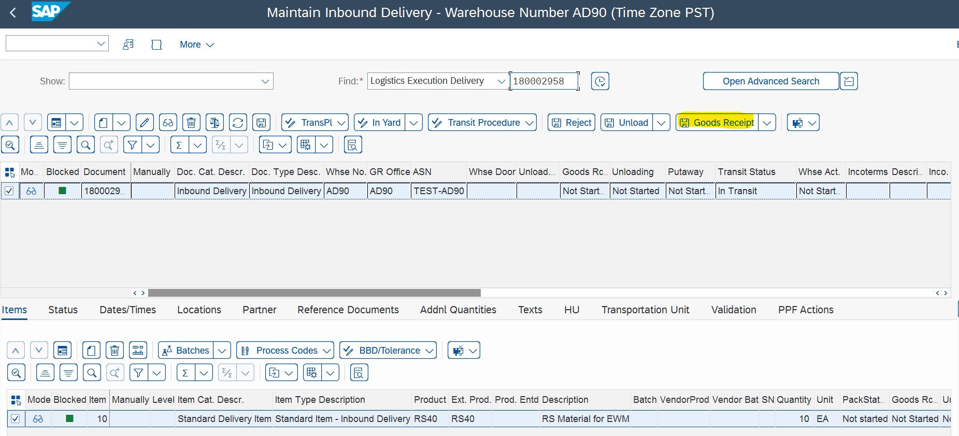
Step 3: Open the inbound delivery in EWM (T-code: /scwm/prdi)
www.anubhavtrainings.com

Slide 8
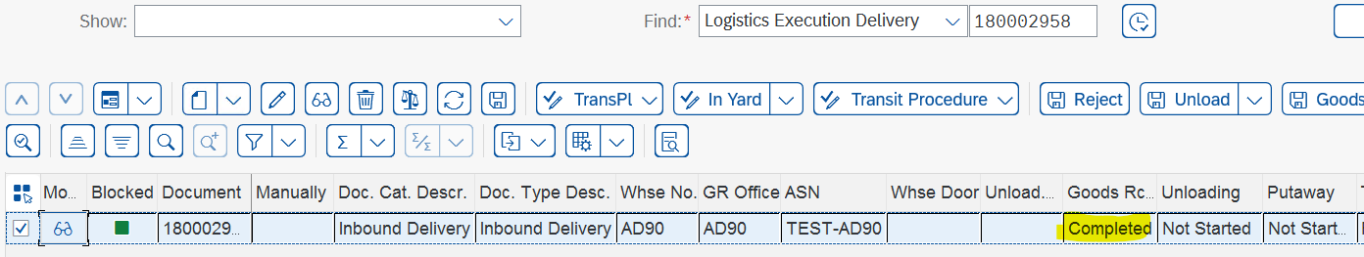
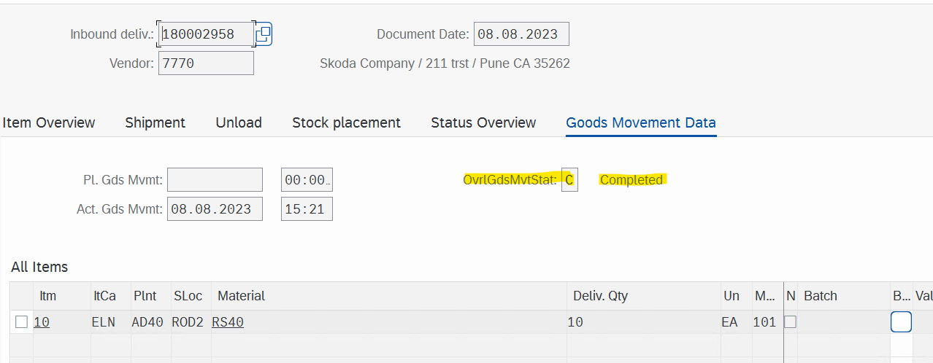
Post the receipt of the goods and proceed with warehouse task creation. Check the GR status once GR is posted.
Once GR is posted, the information flows back to S/4, and a material document is created which can be seen in the following screenshot.
www.anubhavtrainings.com

Slide 9
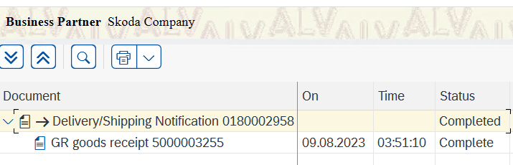
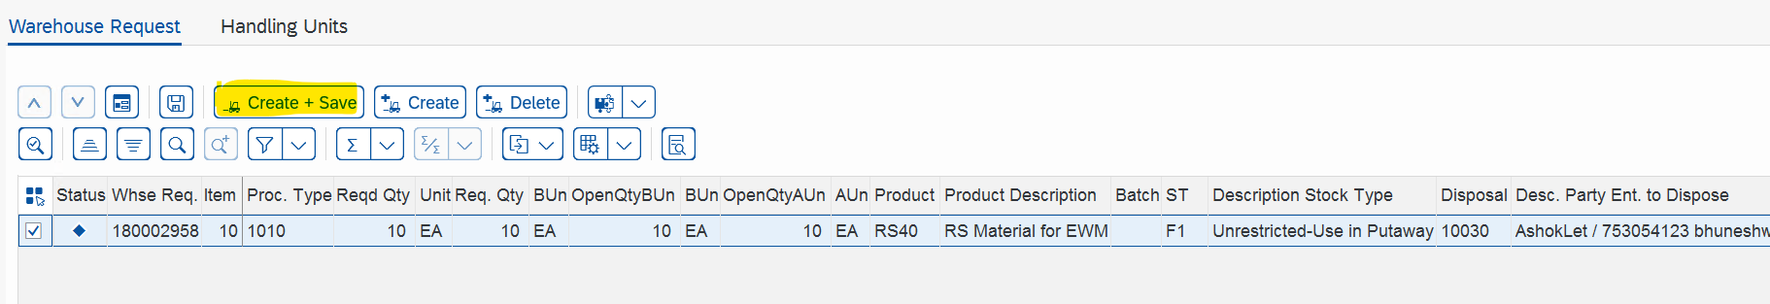
Step 4: Create warehouse task:

Slide 10
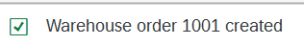
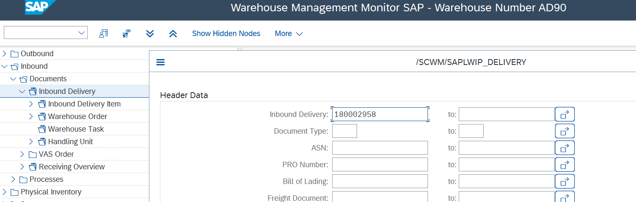
Once you click on create + save warehouse task will be created and automatically a warehouse order will be generated by the system.
Step 5: Confirm the warehouse order (T code: /scwm/mon)
Open the warehouse monitor and expand the tree Inbound > Documents > Inbound delivery and open your inbound delivery.

Slide 11
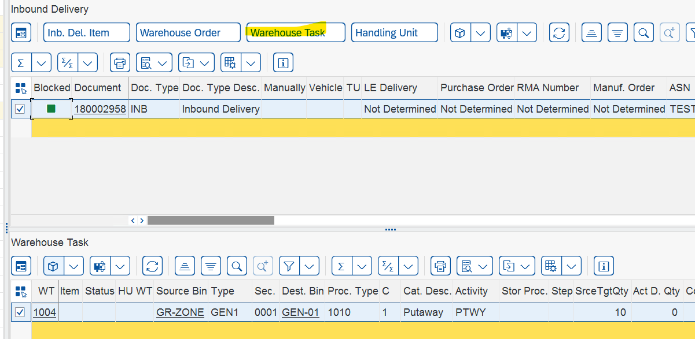
Open the warehouse task > Select more method and confirm WT in background.

Slide 12
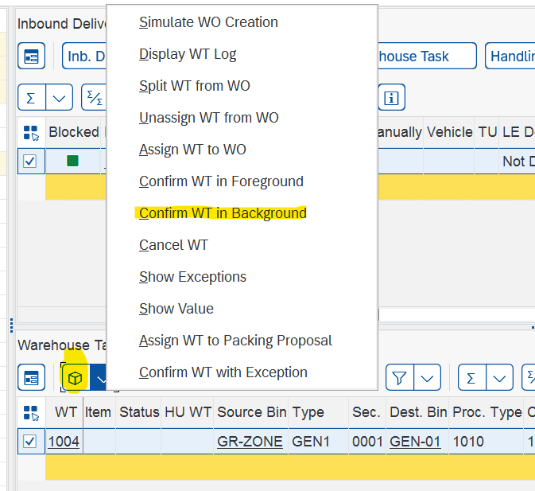
On confirmation, you will receive the following messages.
www.anubhavtrainings.com

Slide 13
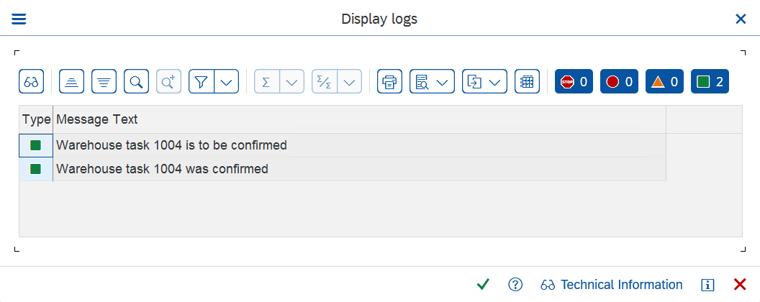

Slide 14
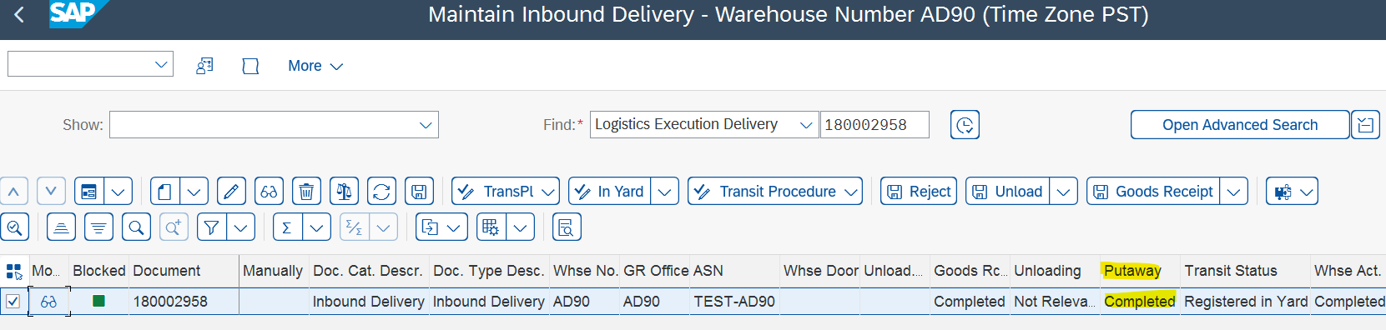
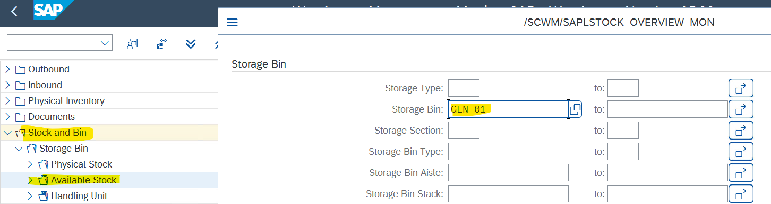
Step 6: Check the Putaway status for your delivery (/scwm/prdi)
Step 7: Check the stock overview in the warehouse monitor.
There are plenty of option in the warehouse monitor to view your stock at bin level.

Slide 15


End of Session
www.anubhavtrainings.com

Slide 16

FEEL FREE TO ASK QUESTIONS

Slide 17

Feedback

Slide 18
THANK
YOU

Slide 19




More from AnubhavTrainings.com

Slide 20






We’re committed to empower you to be
#FutureReady
through powerful training solutions.
We build the workforce of the future.
250+
Corporate Clients
30,000+
Learners Trained
25000+
Learners Placed
FREE WEBINARS
Sign up for free webinars with industry experts every fortnight!
Enroll Now!

Slide 21
FREE WEBINARS
Sign up for free webinars with industry experts every fortnight!
Contact us today!
www.anubhavtrainings.com

